Slide 1
UArizona ASCEND: Profiling High-Altitude Radiation with a General Data Logger
University of Arizona ASCEND Launch Fall & Spring
Speakers:
Nick Blanchard, Kevin May, Daniel McConville

Slide 2
Agenda
Introduction
Fall launch and details
Spring launch and details
Lessons learned

Slide 3
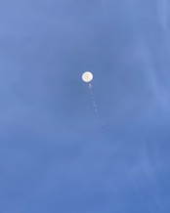
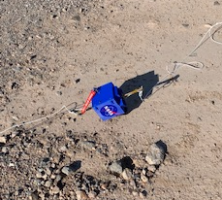
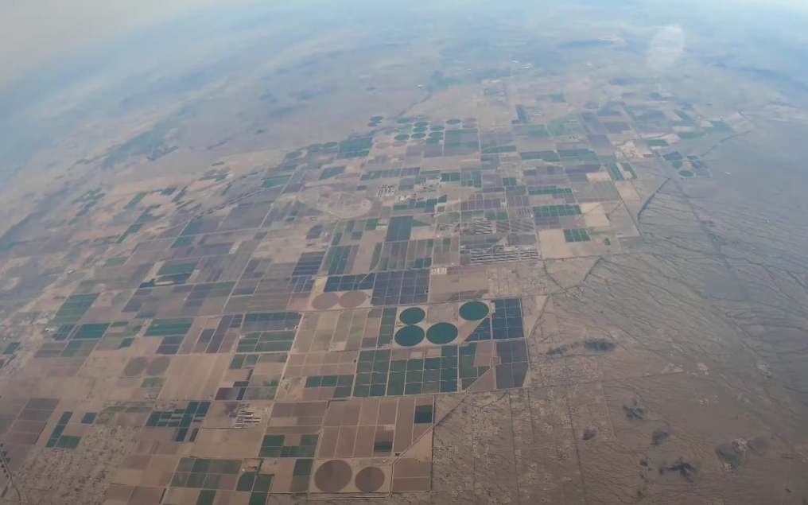
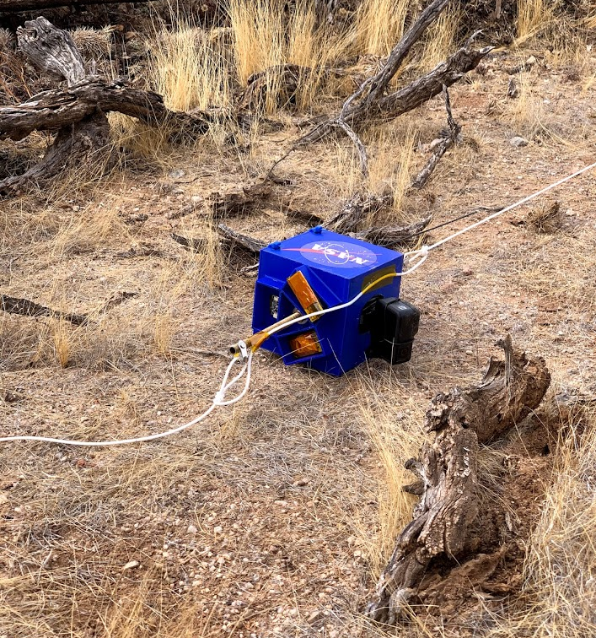
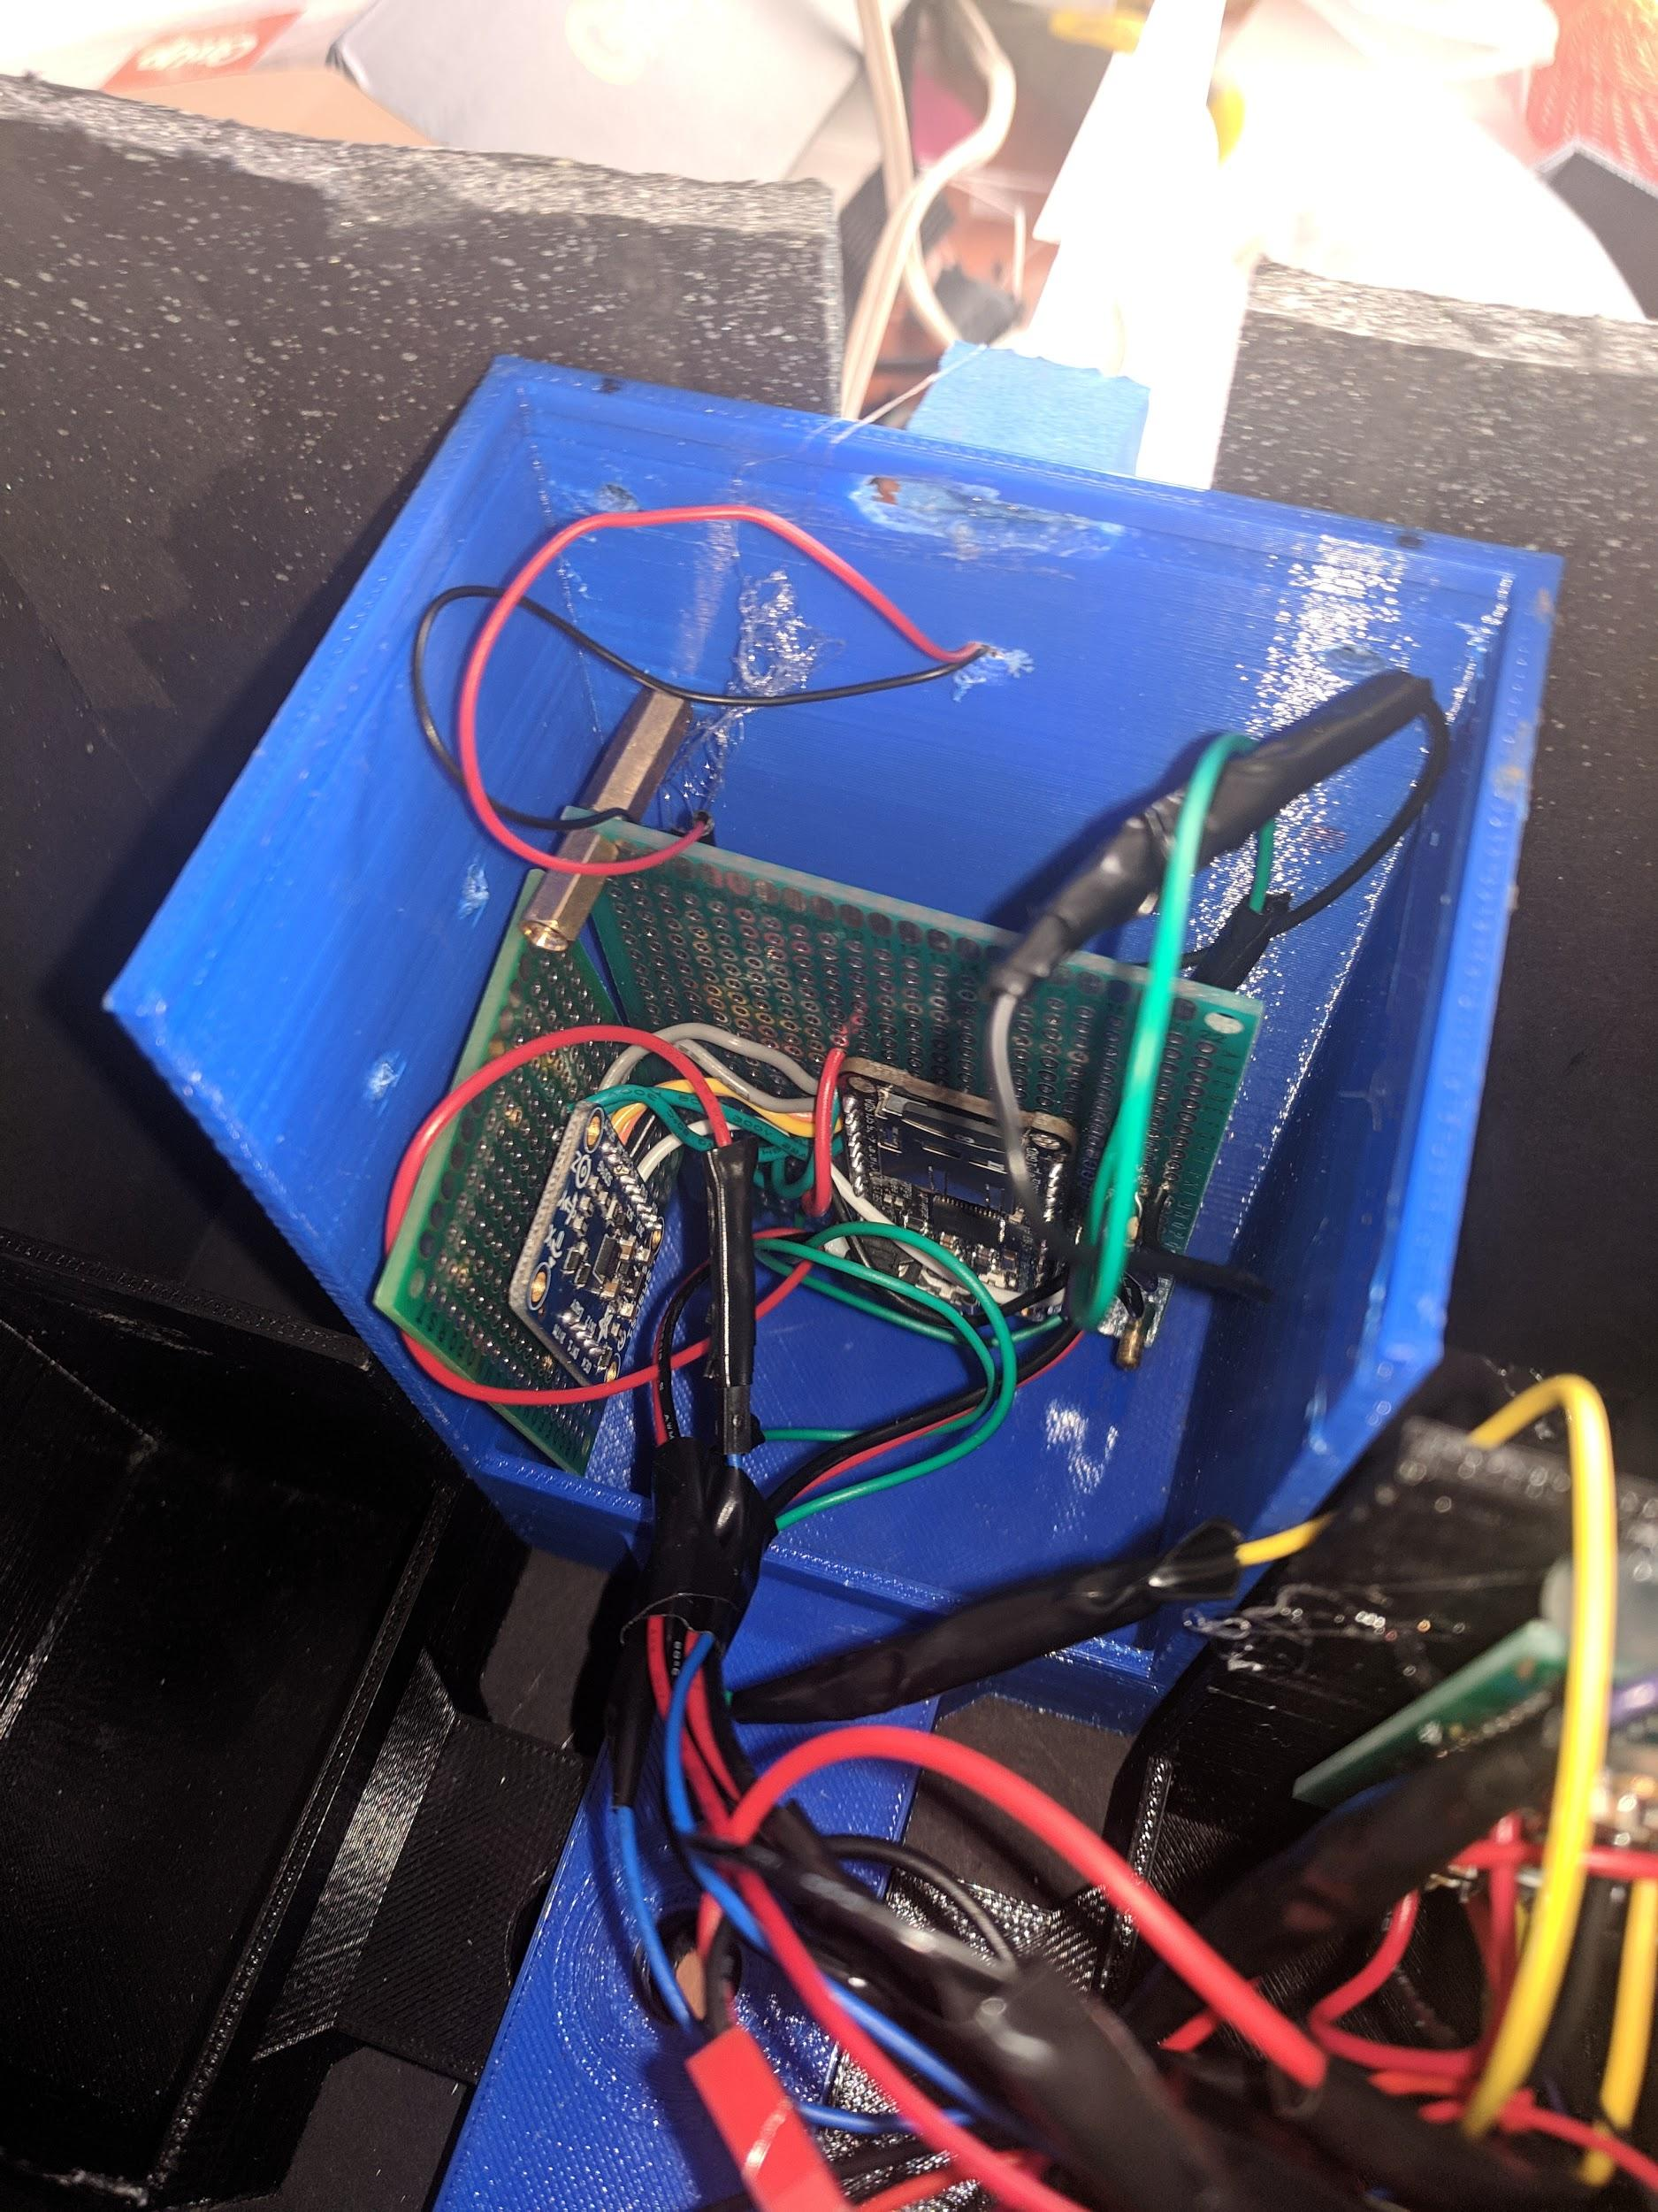
Fall Launch
In flight
Launch
Landing
Notes:
Investigations
Verification of electronics design for atmospheric data collection
Preliminary data future radiation shielding experiments
New videography method
Failure
Wiring
Housing design poor for wire management, led to damage

Slide 4
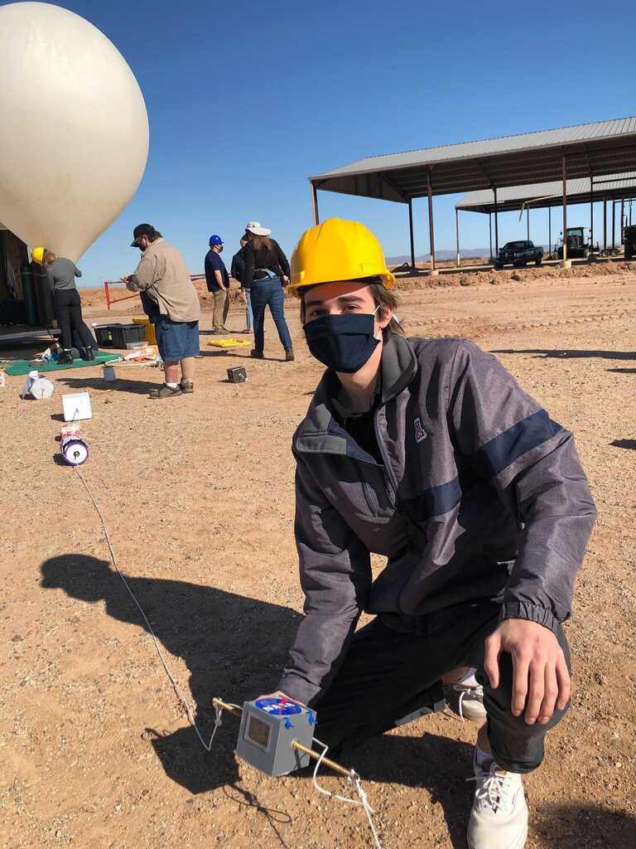
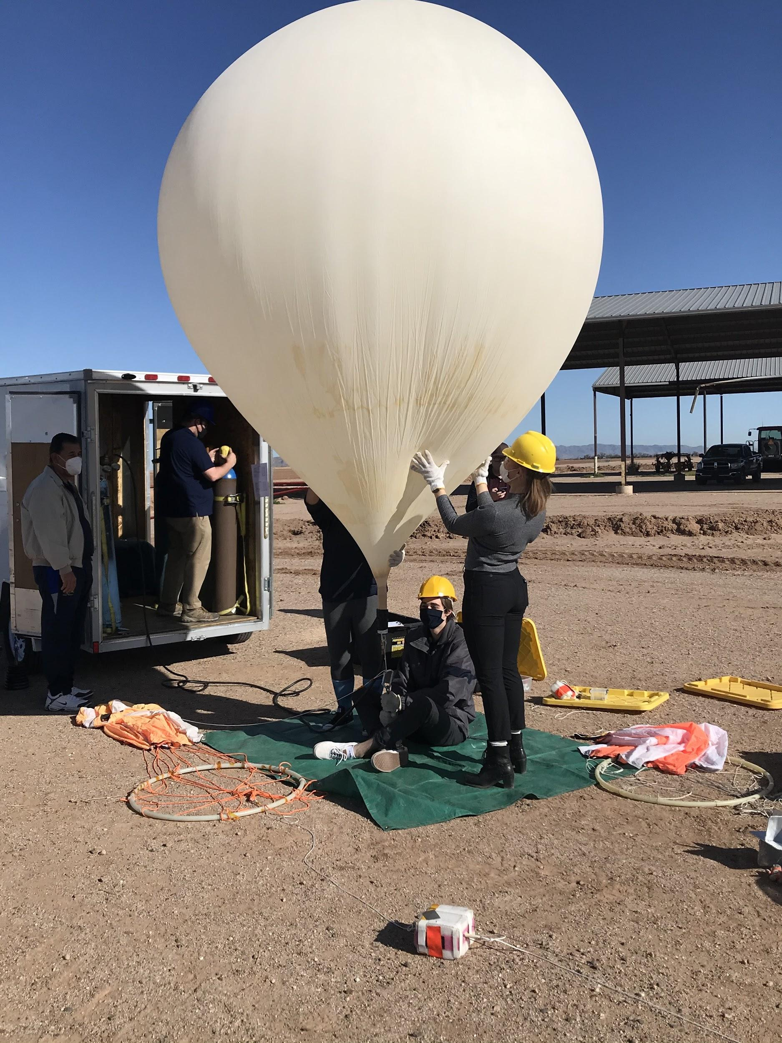
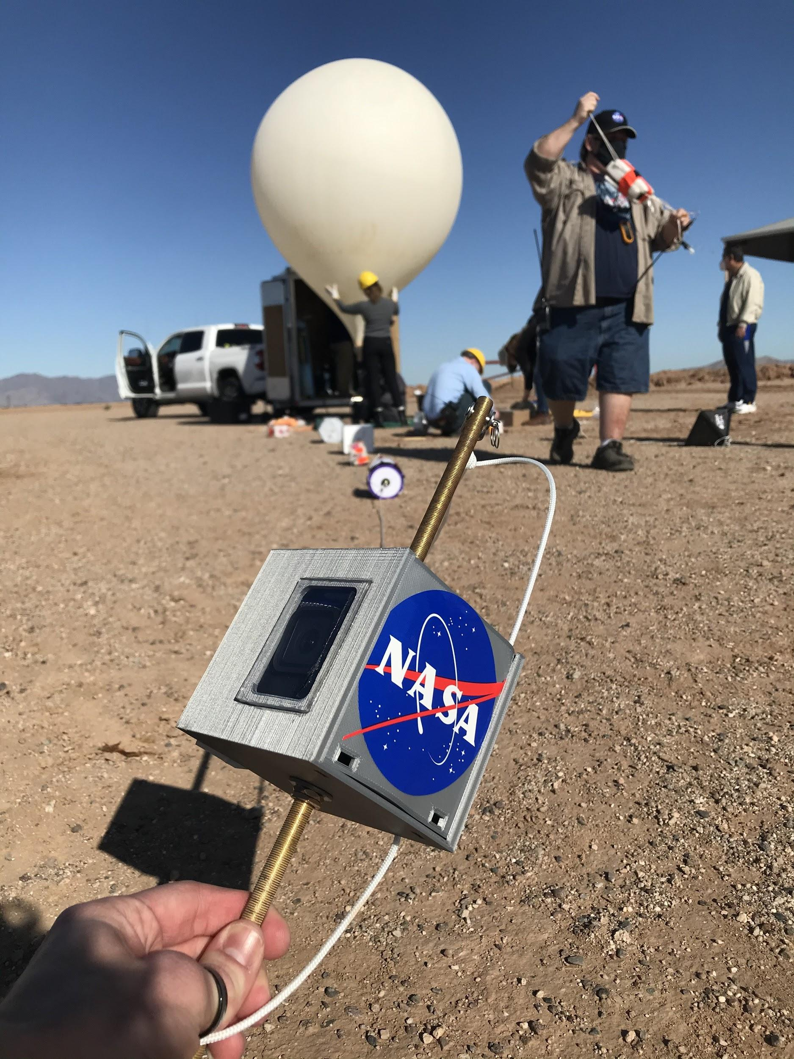
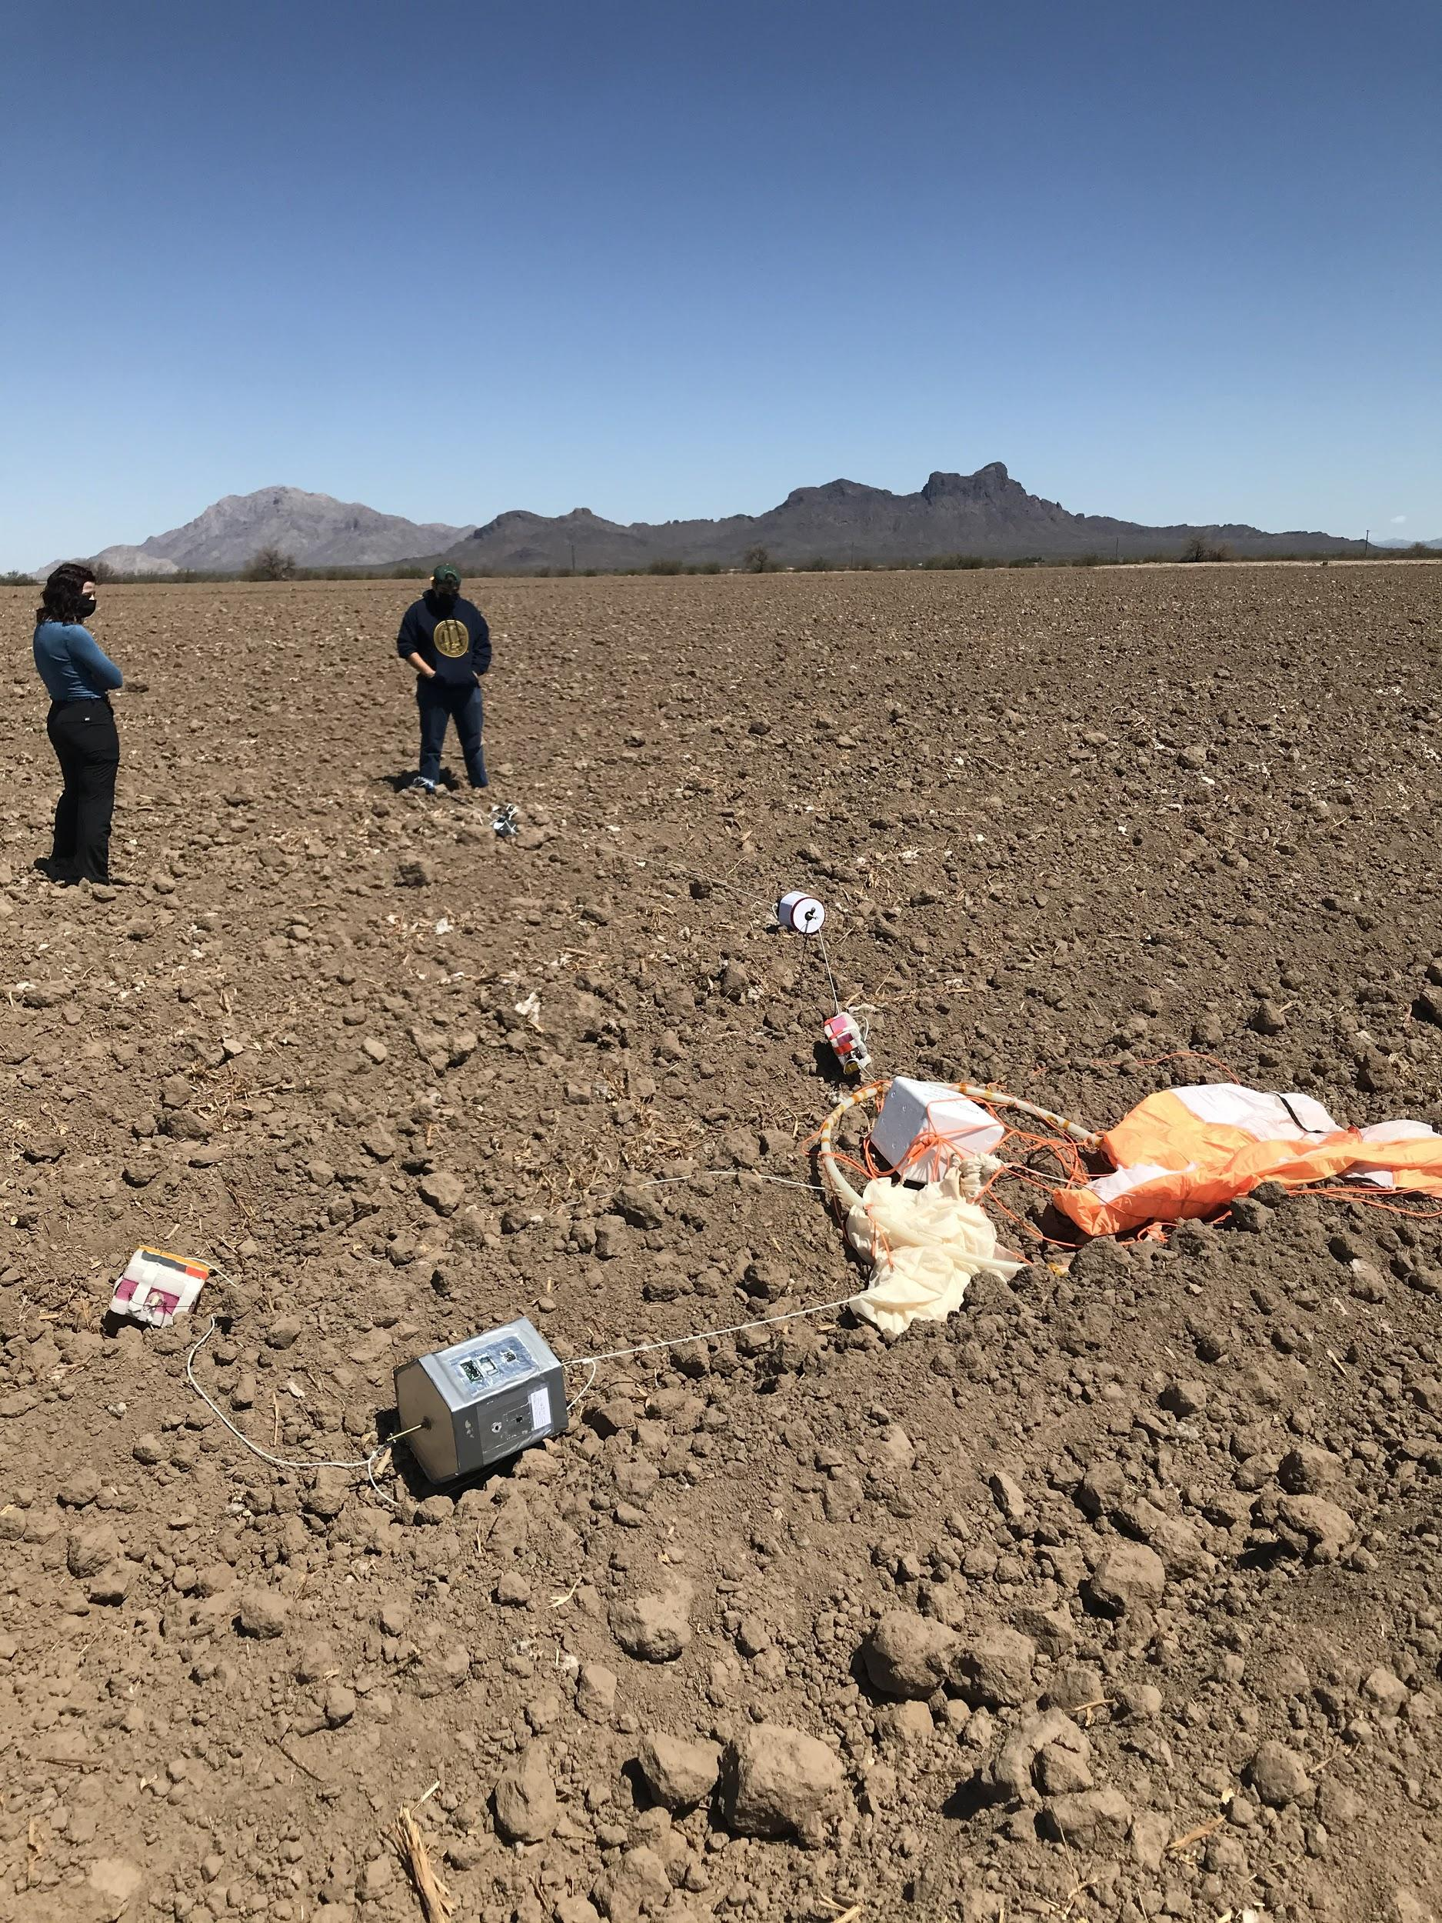
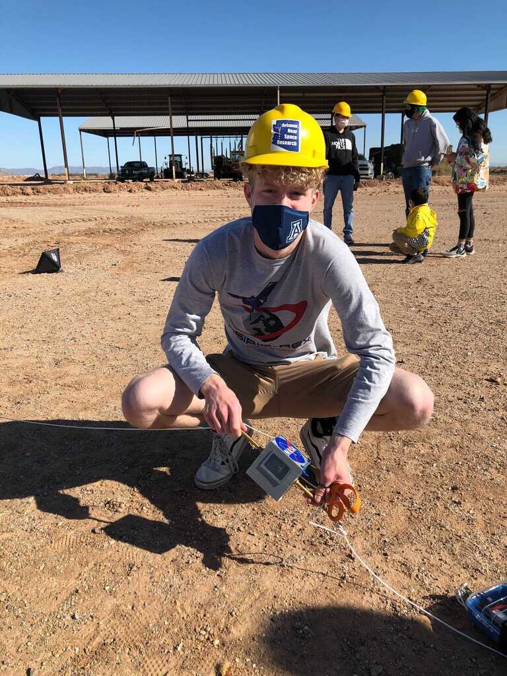
Spring Launch
Notes:
Investigations
Again...verification of electronics design for atmospheric data collection
Preliminary data future radiation shielding experiments
New housing design to fit all components inside

Slide 5
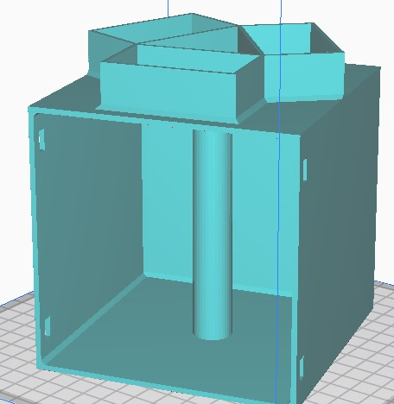
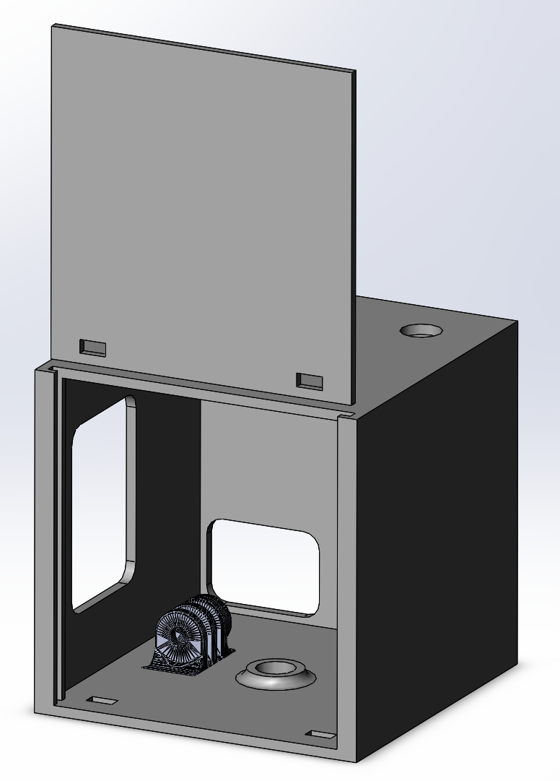
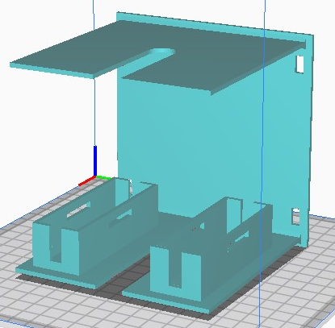
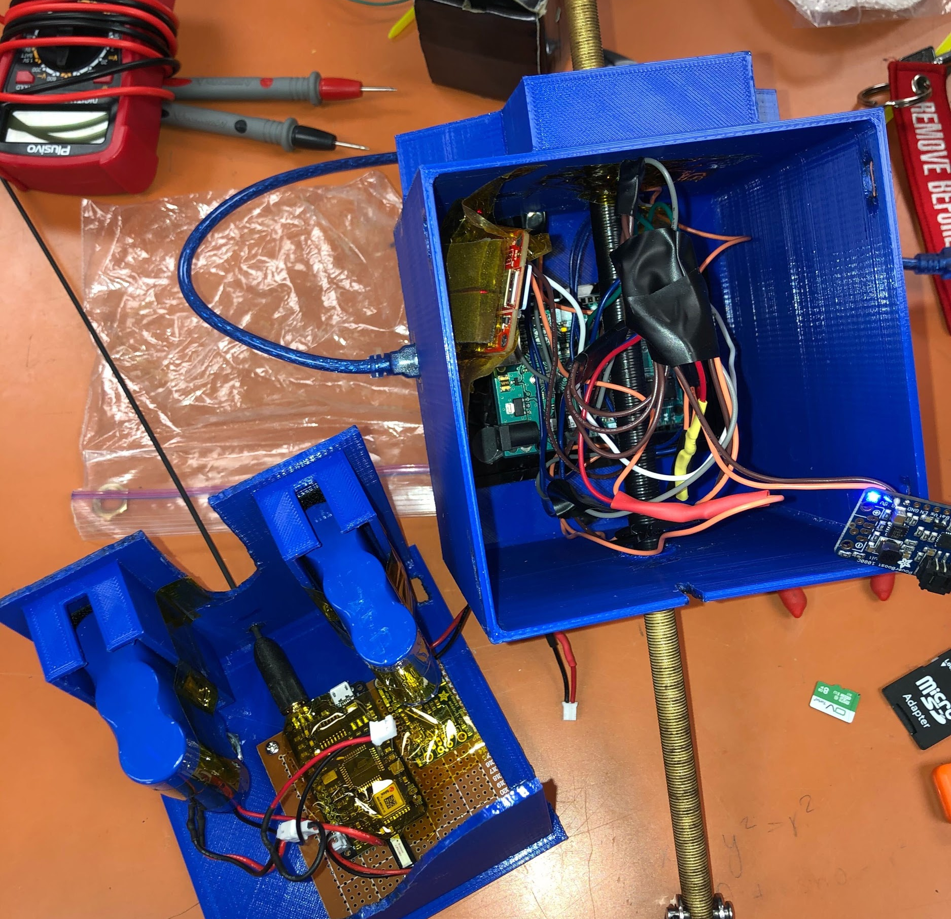
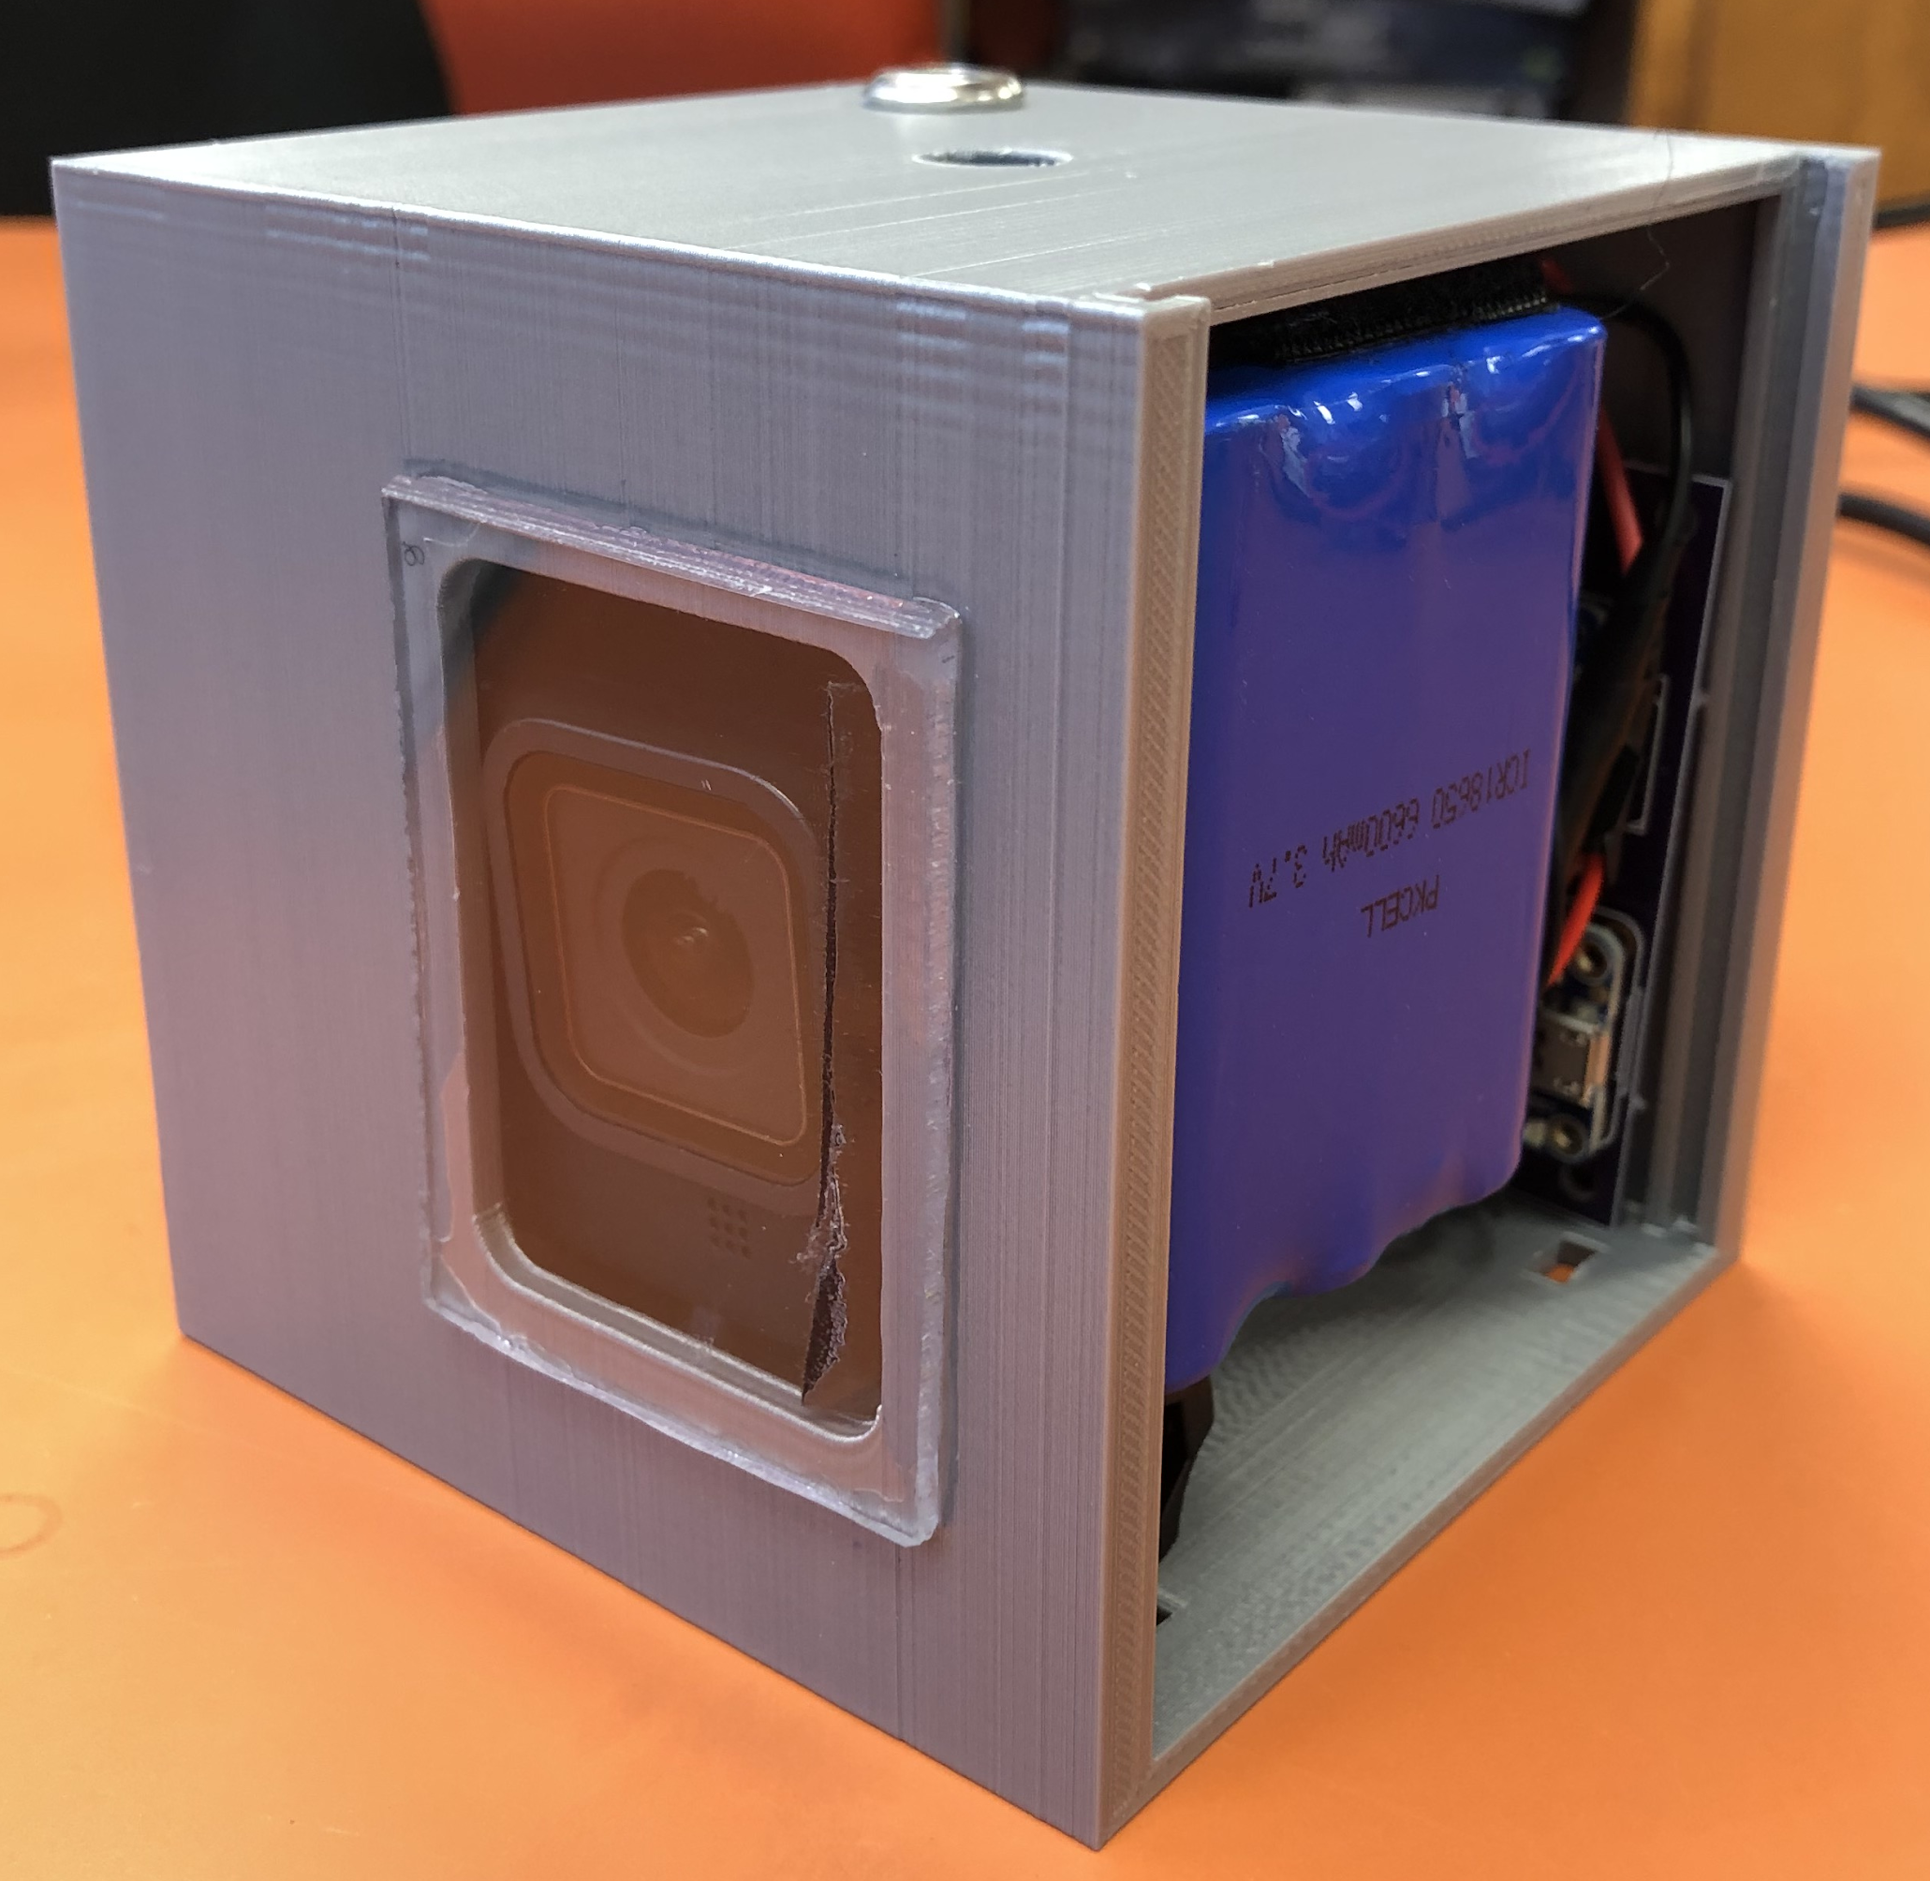
Housing Design
Fall Housing
3D Printed (PLA)
12x12x12cm
GoPro & Geiger counters mounted on exterior
Spring Housing
3D Printed (PLA)
1U Standard CubeSat (10x10x10cm)
All components inside — most compact design yet
GoPro views through polycarbonate window
Housing
Complete
Drawer
Design
Complete
Notes:
Fall housing
Interior dedicated to electronics
Unable to use PCB designed in Spring since a part specified from Spring was no longer available in Fall
Required impromptu wiring which made failure far more likely
Drawer contained batteries and electronics
Temperature, pressure, humidity, radio components
Top-mounted geiger counters (2X)
Side mounted, exterior GoPro
“Time warp” mode in 4k resolution
Successful video capture (despite only ~45 minutes) and radio transmitter function
Spring housing
Interior desiccated to fit everything
PCB allowed for better fitment
1 3-cell LiPo, 1 2-cell LiPo
GoPro with polycarbonate window
Initially intending to run GoPro from main batteries
Voltage issue prevented camera from working properly
Decided to run at lower resolution and framerate to preserve battery life in retail GoPro battery
Since Fall failed with data collection, this presentation focuses on the Spring payload

Slide 6
Electronics (Spring Payload)
Component | Purpose
Adafruit Metro Mini (ATMega328) | Microcontroller
Adafruit BME 680 (I2C) | Atmospheric Profiler
Adafruit MMA 8451 (I2C) | 3-Axis Accelerometer
RadiationWatch Pocket Geiger | Radiation Measurements
Adafruit MicroSD Card Module (SPI) | Datalogging
Adafruit Powerboost 1000c | Power Delivery
11000 mAh LiPo | Power Storage
Status LED | Display System Status
Notes:
Mention changes from Fall payload

Slide 7
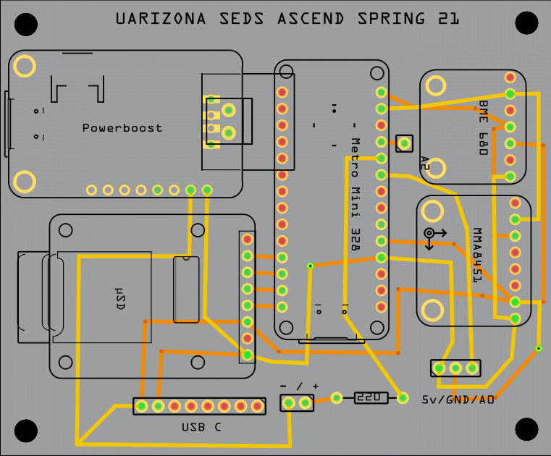
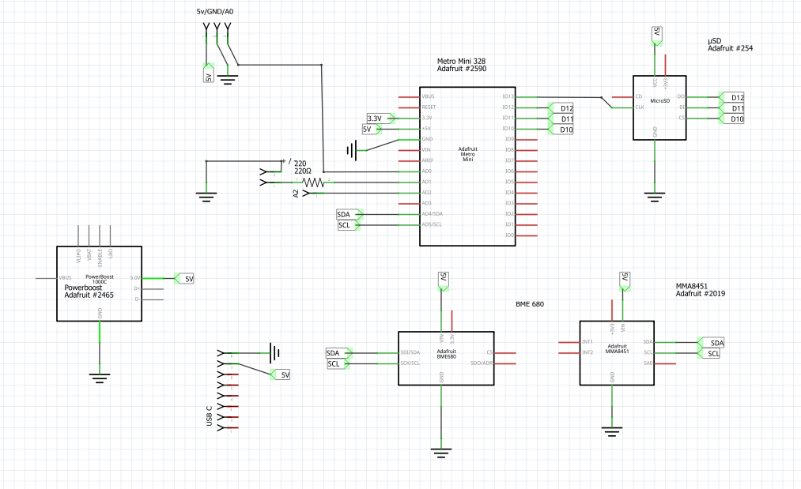
Schematic and PCB

Slide 8
Spring Data + Conclusions

Slide 9

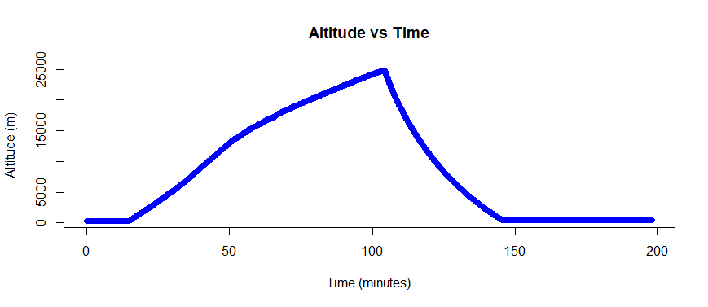
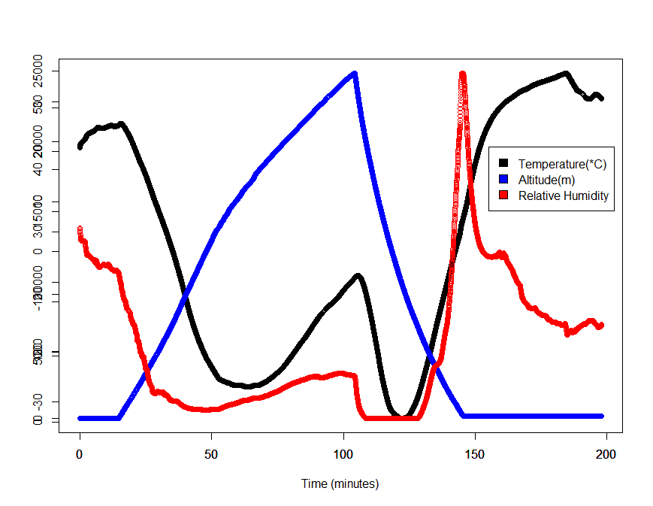
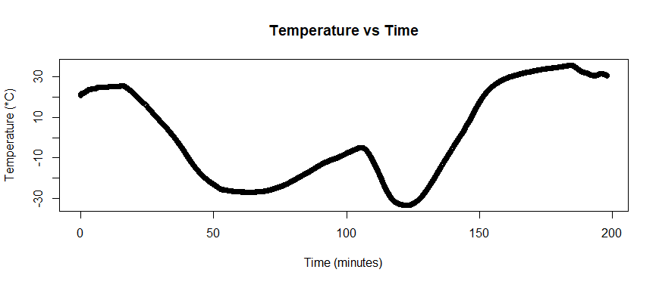
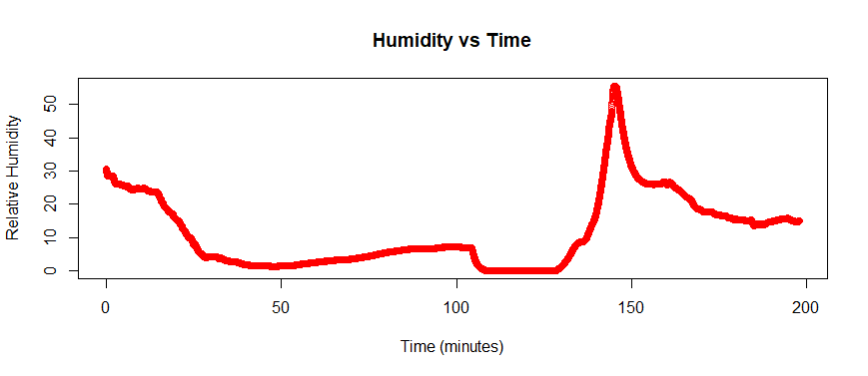
Atmospheric Data

Slide 10
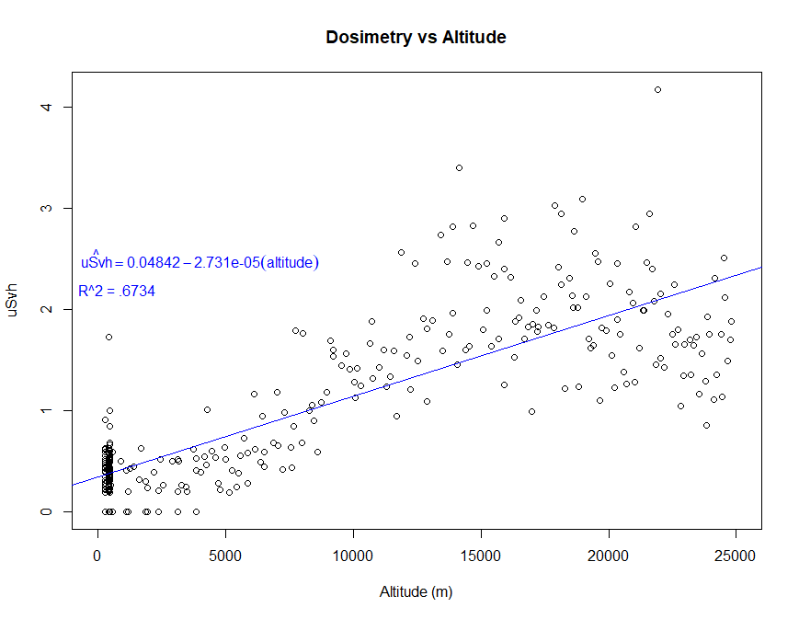
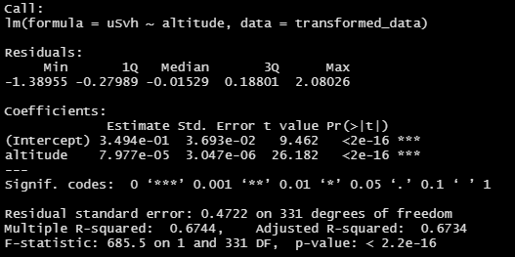
Radiation Intensity Data
95% Confidence Interval for Beta (Slope):
7.367*10^-5 < Beta < 8.5864*10^-5

Slide 11
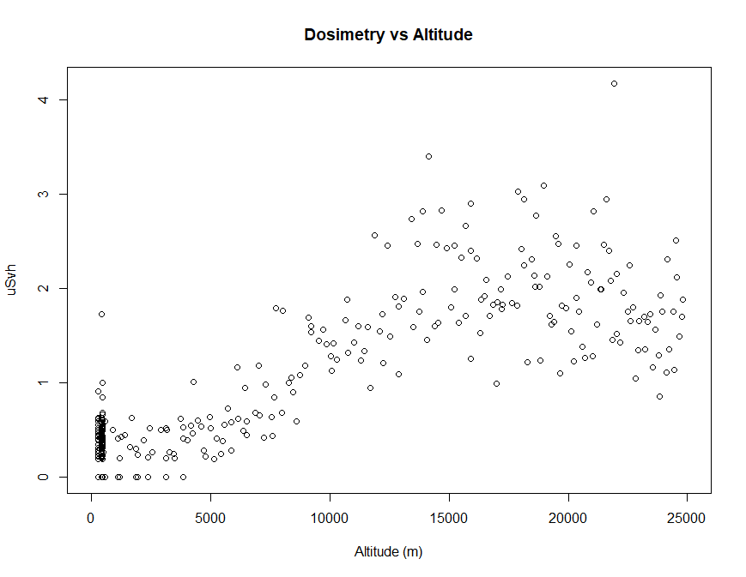
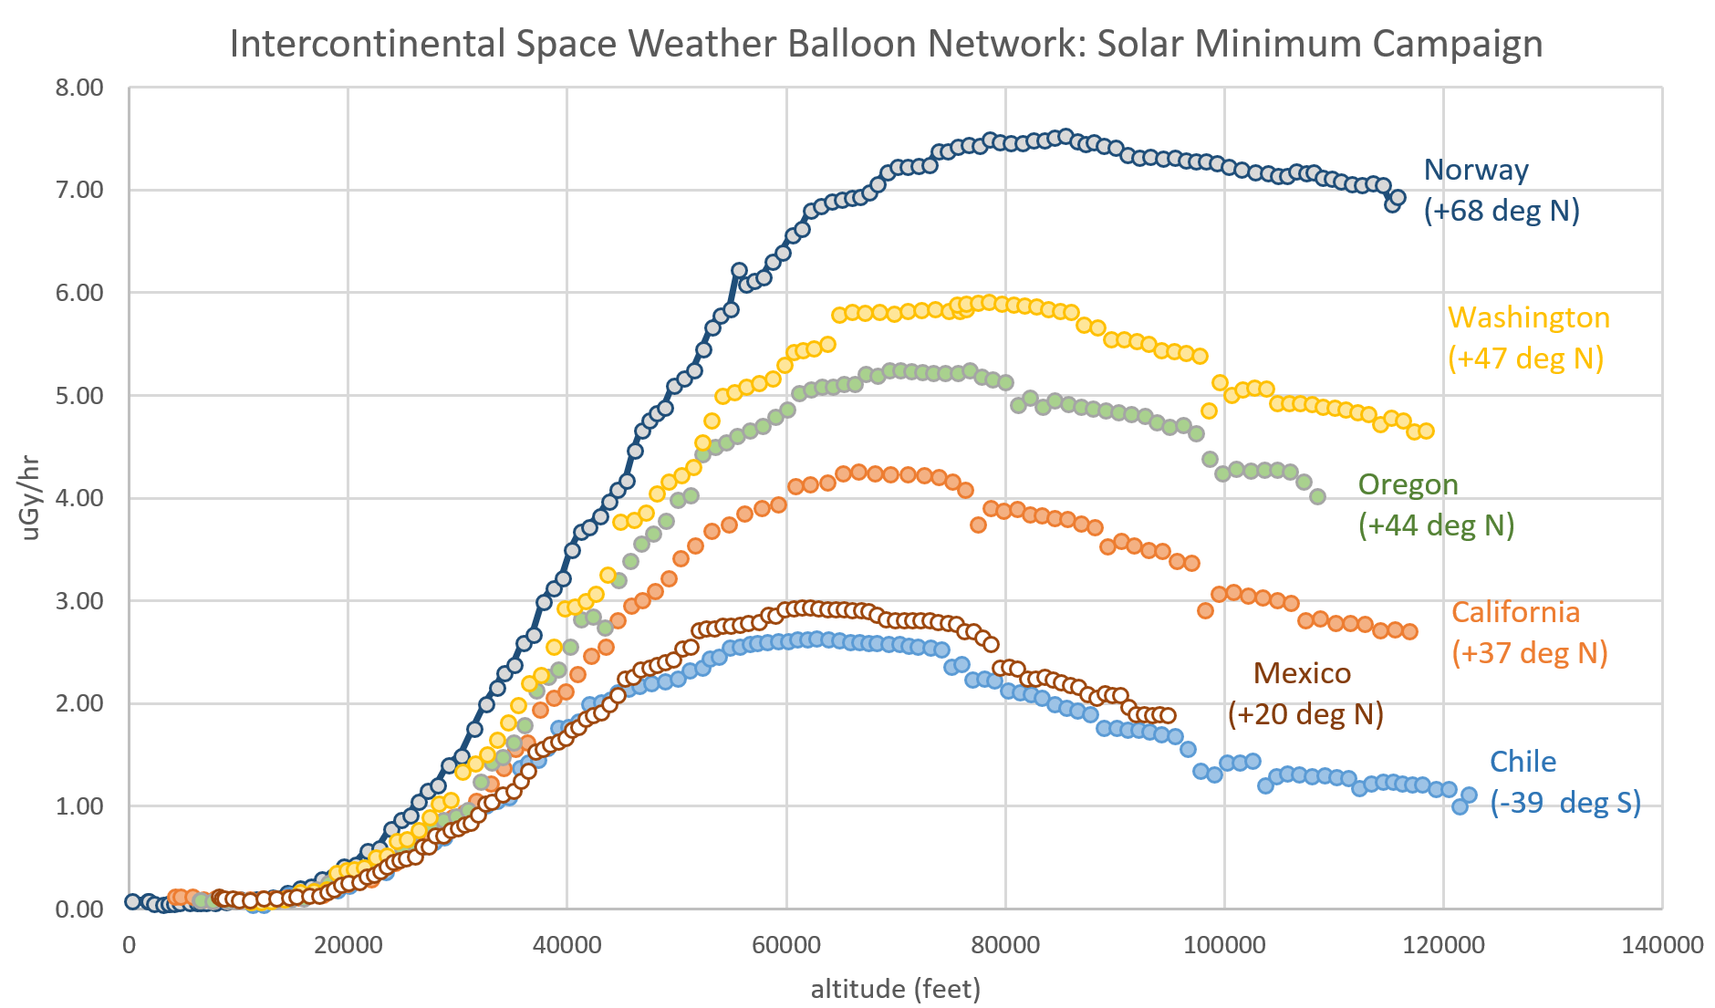
Interpretation of Radiation Data
(Phillips 2016)
Notes:
Case can be made for a low-cost, safe radiation test bench

Slide 12
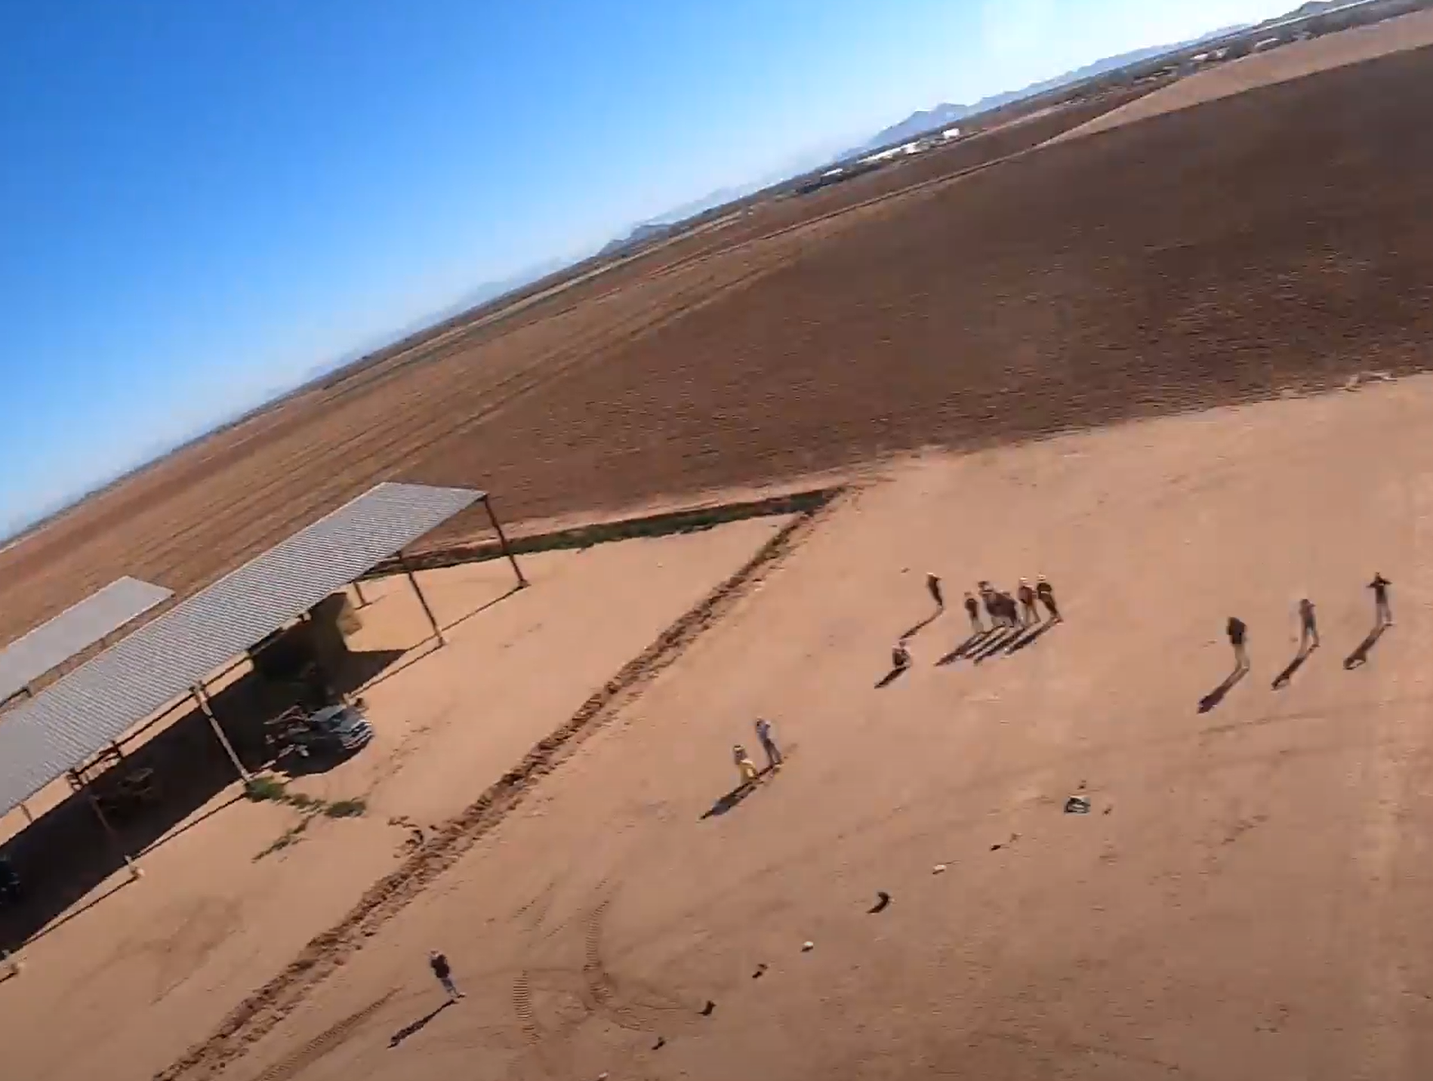
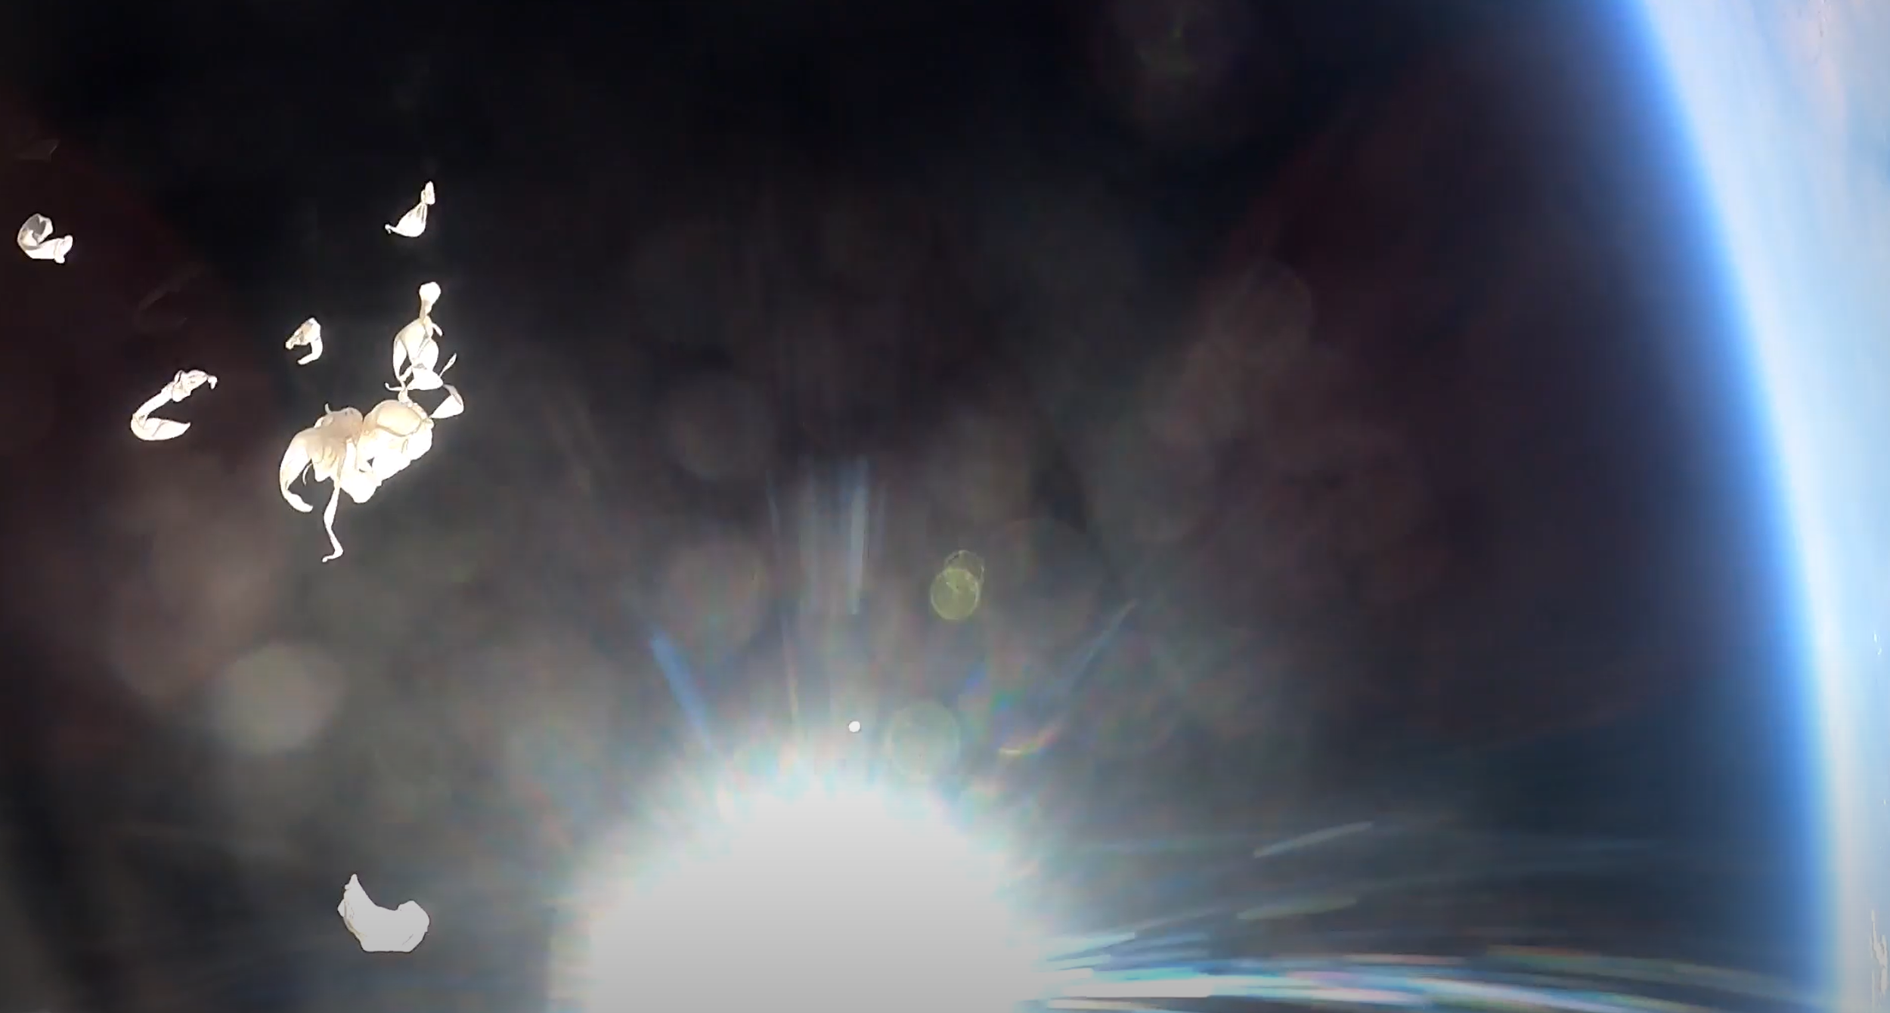
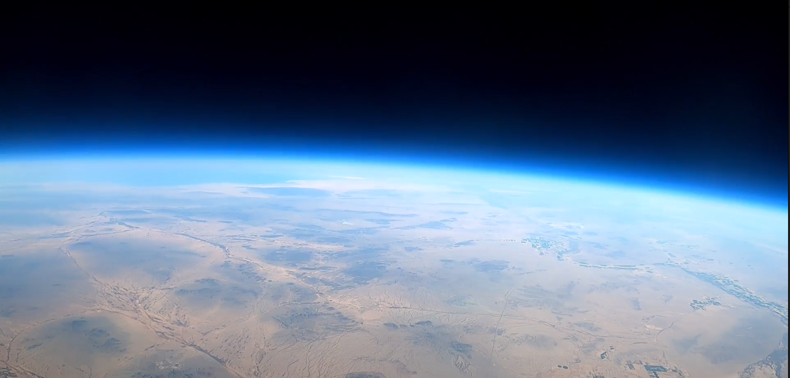
Spring Launch Video Screenshots

Slide 13


Thank You
Arizona Near Space Research
Arizona Space Grant Consortium
Michelle Coe
Radiation Reference: Dr. Tony Phillips, “Intercontinental Space Weather Balloon Network”
https://spaceweatherarchive.com/2016/11/05/intercontinental-space-weather-balloon-network/
arizonaseds@gmail.com
www.seds.arizona.edu

